Slide 1

Laptop Price Predictor: Machine Learning Project
This study explores predicting laptop prices using supervised machine learning models such as Linear Regression, K-Nearest Neighbors, Decision Tree, and Random Forest. The Random Forest model achieved the best performance with an R² score of 0.88, improving from an initial 0.80. This demonstrates the value of predictive modeling based on hardware specs for consumers and retailers to understand laptop pricing dynamics.
Team Members:
Ashwin Santhanakrishnan
Aswath Santhanakrishnan

Slide 2
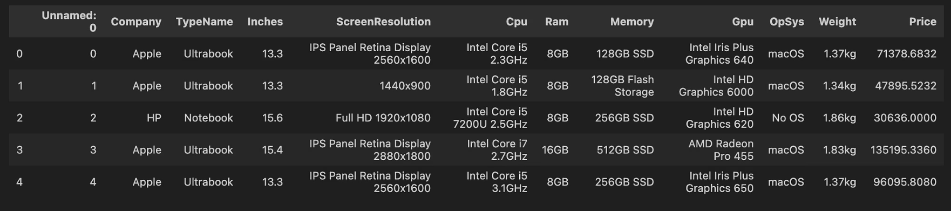
Dataset Overview and Key Features
1
Dataset Details
Contains 1,303 laptop records with 12 attributes, including company, type, screen size, resolution, CPU, RAM, memory, GPU, OS, weight, and price.
2
Statistical Summary
Prices range from ₹9,270 to ₹324,954, with an average of ₹59,870. Dell is the most frequent manufacturer, and Notebook is the most common laptop type.
3
Feature Diversity
Includes 19 companies, 40 screen resolutions, 118 CPU brands, and 110 GPU types, reflecting a wide range of laptop configurations.

Slide 3
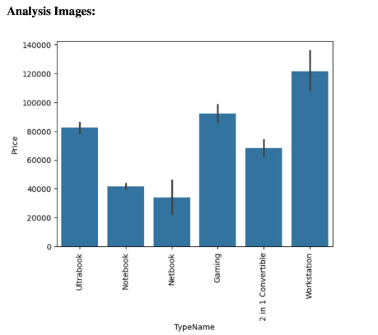
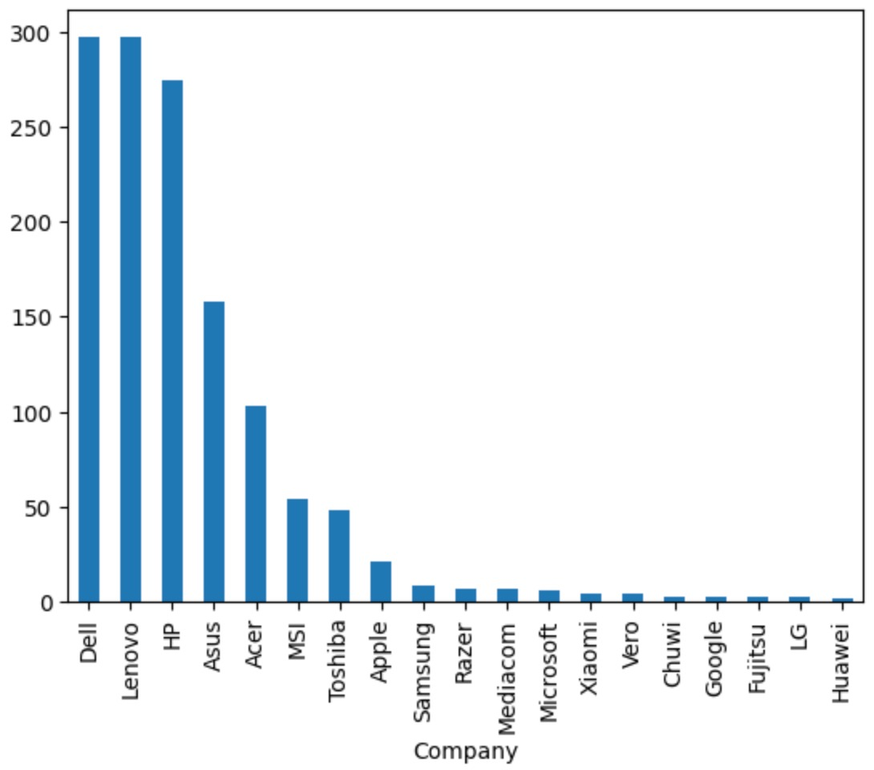
Exploratory Data Analysis (EDA)
Feature Correlations
Price Distribution by Brand
Hardware specifications such as increased RAM size and SSD capacity show a strong positive correlation with laptop price.
Established brands like Dell tend to price laptops higher than many competitors due to brand reputation and quality assurance.
Some features, however, display weak or even negative correlations, indicating varying impacts on pricing.
We observe a clear correlation between manufacturer reputation and laptop price across the dataset.
Notably, workstations represent the highest production type among laptops in this dataset, influencing overall price trends.
EDA confirms that pricing strategies are strongly influenced by manufacturers' standing in the market and customer perception.

Slide 4
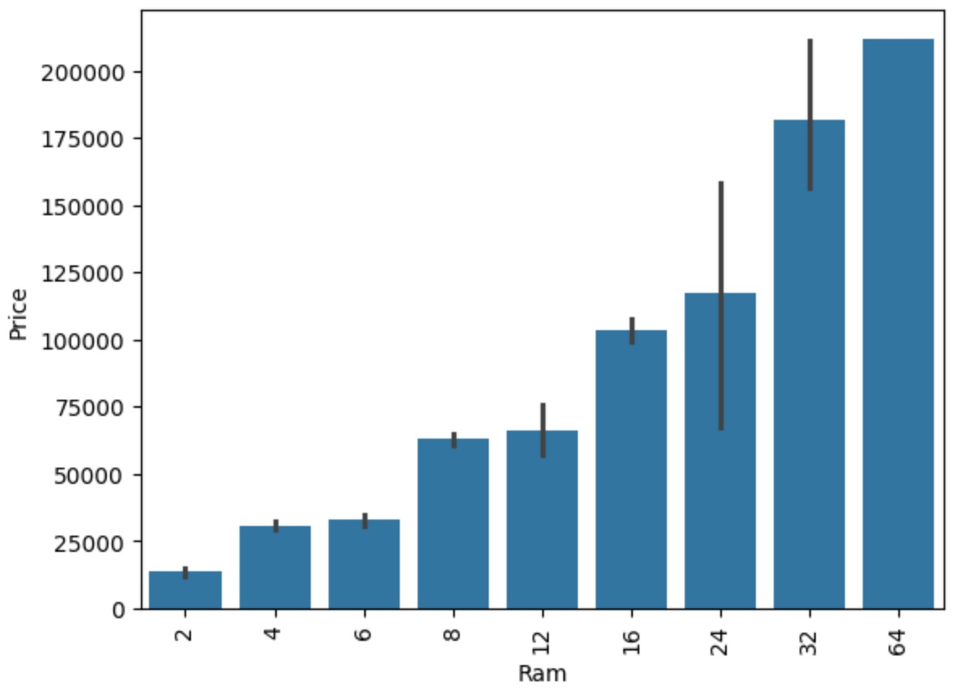
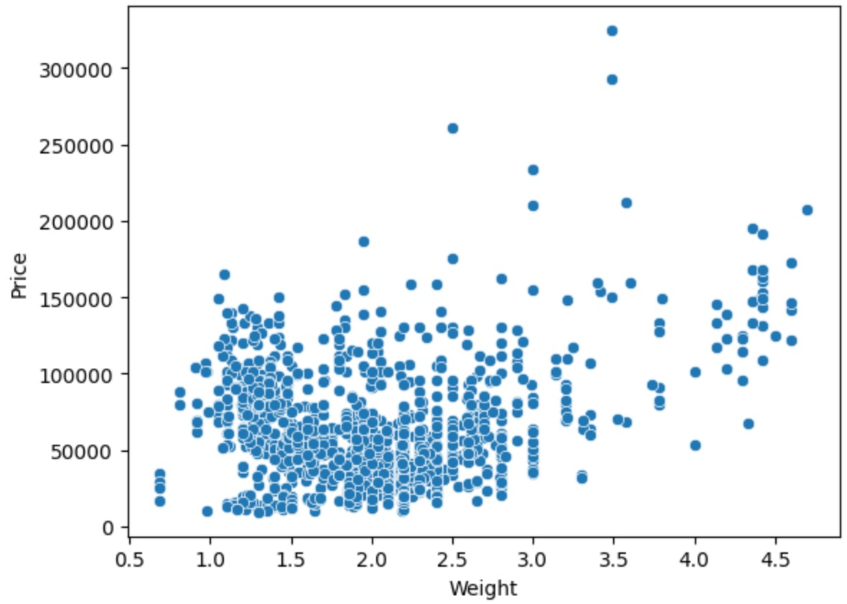
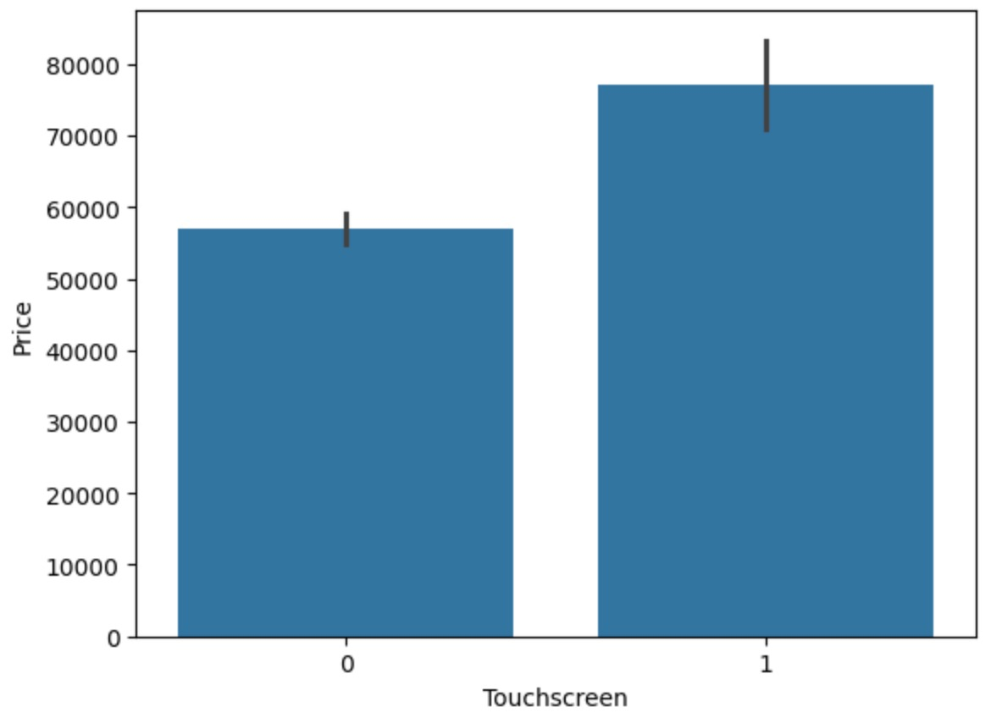
More Analysis on the data

Slide 5

Machine Learning Models and Why?
1
Linear Regression
2
K-Nearest Neighbors (KNN)
What it is: A basic regression algorithm that models the linear relationship between the features and the target (price).
What it is: A non-parametric algorithm that predicts a value based on the average of the K most similar data points.
Why I used it:
Why I used it:
Acts as a baseline to compare more complex models.
Works well when similar configurations tend to have similar prices.
Interpretable — helps understand which features are most influential.
Captures local patterns and relationships.
Quick to train and test.
Useful for observing performance in a distance-based context.
3
Decision Tree Regressor
4
Random Forest Regressor
What it is: A tree-based algorithm that splits the data based on feature thresholds to predict values.
What it is: An ensemble method that builds multiple decision trees and averages their results for better generalization.
Why I used it:
Why I used it:
Captures non-linear patterns and feature interactions.
Typically outperforms single models in accuracy.
Easy to interpret visually.
Reduces overfitting by averaging multiple trees.
Handles both categorical and numerical data without scaling.
Was the best-performing model in terms of R² and lowest MAE/MSE.

Slide 6

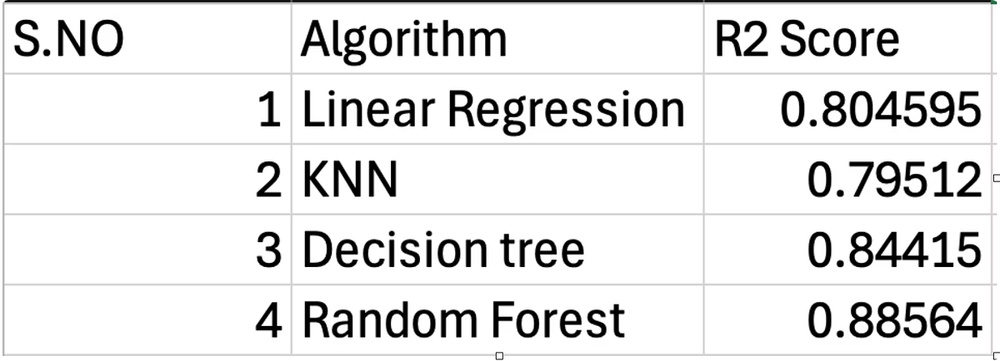
Random Forest: Best Model for Price Prediction
The Random Forest model achieved the highest R² score of 0.88 and the lowest mean absolute error of 0.1607, making it the most reliable for laptop price forecasting. Its ensemble approach reduces overfitting and handles diverse feature sets effectively.
This model's superior performance highlights the advantage of combining multiple decision trees to improve prediction accuracy in complex datasets.

Slide 7

Model Performance Comparison
Model
R² Score
Mean Absolute Error (MAE)
Mean Squared Error (MSE)
Linear Regression
0.804
0.2104
0.07475
KNN
0.795
0.1966
0.07837
Decision Tree
0.842
0.1852
0.06077
Random Forest
0.88
0.1607
0.04375

Slide 8
Applications and Benefits of the Predictor
For Consumers
For Retailers
Provides accurate price estimates based on hardware specs, helping buyers make informed decisions within their budget.
Enables competitive pricing strategies by forecasting market prices, aligning product offerings with customer preferences.

Slide 9

Future Directions and Enhancements
Web-Based Deployment
Develop a real-time web application for dynamic laptop price guidance accessible to users globally.
Advanced Models
Incorporate neural networks and gradient boosting algorithms to further improve prediction accuracy.

Slide 10
Conclusion
The Laptop Price Predictor project successfully demonstrated the power of machine learning models in accurately forecasting laptop prices based on hardware specifications.
Among the various models tested, the Random Forest showed superior performance, highlighting the effectiveness of ensemble methods for regression tasks in complex datasets.
Future improvements and deployment will enhance the predictor's usability and accuracy, making it a valuable tool for consumers and retailers alike.

